Slide 1
Class And Objects

Slide 2

Class
A class is a User Defined datatype
A Collection of Data Member and Member functions
A Blueprint of your objects
Notes:
How do we create a class
Using following syntax
class className {
// some data
// some functions
};

Slide 3
Objects
When a class is defined, only the specification for the object is defined; no memory or storage is allocated.
To use the data and access functions defined in the class, we need to create objects.
Notes:
When a class is defined, only the specification for the object is defined; no memory or storage is allocated.
Syntax
className objectVariableName;

Slide 4
Data members and Member Functions
Data members are the data variables
member functions are the functions used to manipulate these variables
Together these data members and member functions defines the properties and behavior of the objects in a Class.

Slide 5
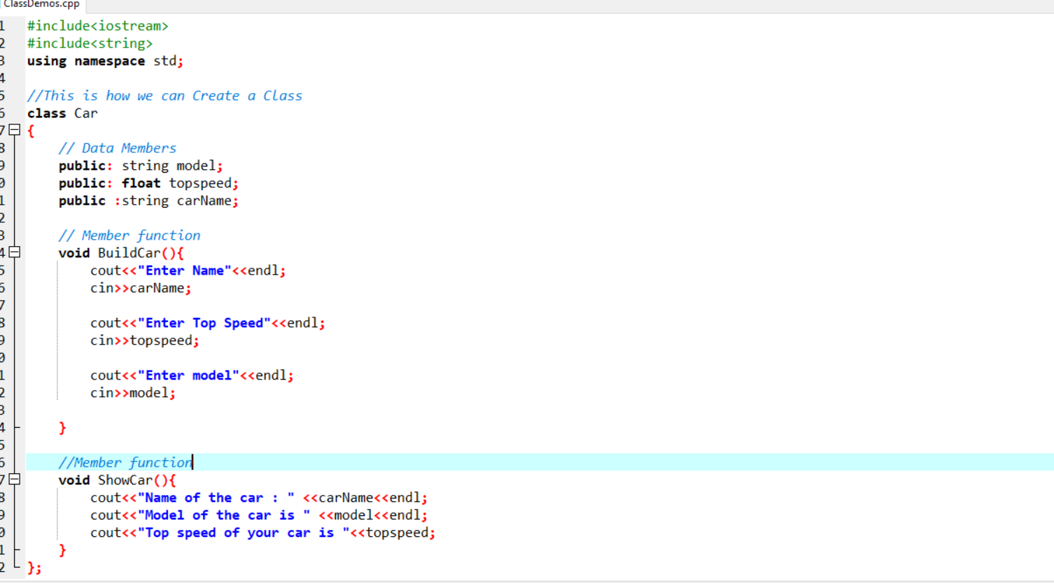
Notes:
A class is a blueprint for the object.
A Class is a User defined datatypes
A Object is a physical reality of the class or Object is a instance of the class

